Slide 1
Content Venue Aware Topic Model for Group Event Recommendation
Mobile App Development with Deep Learning
KAVIRAJ A (2017PECCS295 / 211417104113)
NAKUL R (2017PECCS309 / 211417104158)
PARANTHAMAN K(2017PECCS320 / 211417104178)
Under the Guidance of
Mr. S SUBBURAJ
ASSISTANT PROFESSOR

Slide 2
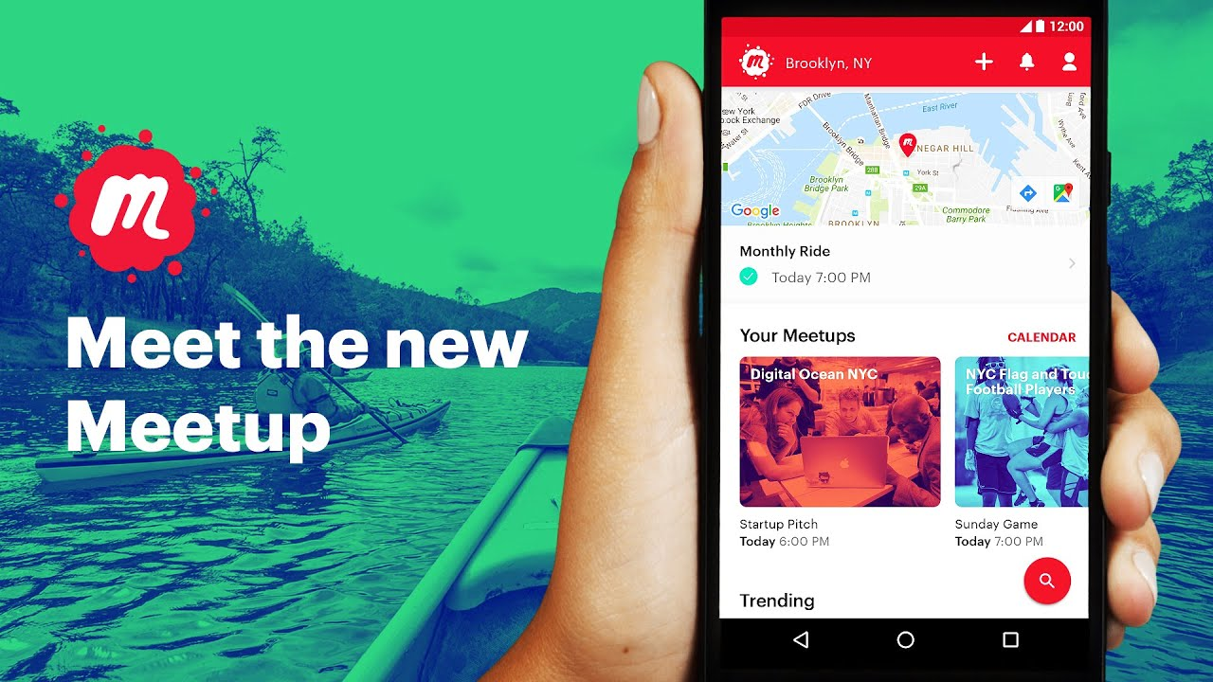
Introduction
Venue recommendation for hosting popular Meet up events is a perfect example of a recommendation problem where multiple entities interact and influence each other.
Selecting suitable venues for hosting events is an important aspect for a venue recommendation.
In this project, we present a deep learning based venue recommendation system deep venue which provides context driven venue recommendations for the Meet up event-hosts to host their events.
This System includes Mobile Application used by common user with deep learning algorithms.

Slide 3
Literature Survey
TITLE | AUTHORS | Discription
Event-based Social Networks: Linking the Online and Offline Social Worlds | Xingjie Liu, Qi Hey, Yuanyuan Tiany, | Conventional online social networks, EBSNs provide an online virtual world where users exchange thoughts and share experiences. In Meet up, users may share comments, photos and event plans with members in the same online social groups
Probabilistic Matrix Factorization | Ruslan Salakhutdinov, Andriy Mnih | Constrained version of the PMF model that is based on the assumption that users who have rated similar sets of movies are likely to have similar preferences. When the predictions of multiple PMF models are linearly combined with the predictions of Restricted Boltzmann Machines models, we achieve an error rate of 0.8861, that is nearly 7% better than the score of Netﬂix’s own system.

Slide 4
Literature Survey
TITLE | AUTHORS | Discription
Content-based Recommender Systems: State of the Art and Trends | Pasquale Lops, Marco de Gemmis | Content-based recommendation systems try to recommend items similar to those a given user has liked in the past. Content-based recommenders are capable of recommending items not yet rated by an user.
Social Recommendation with Cross-Domain Transferable Knowledge | Meng Jiang, Peng Cui, Xumin Chen, Fei Wang, Wenwu Zhu | Various factors of item transferability, including popularity and behavioral consistency, are determined. Extensive experimentation on a large real social dataset demonstrates that HRW produces signiﬁcantly superior recommendations for web posts on social networks.

Slide 5
Problem Statement
There are many Event recommendation application like Meetup.com,Letsgather,etc,.All this application works around a fixed source.We need a better solution.
The venue recommender needs to rank all the venues according to their abilities of making the event successful.The key challenge in developing deep venue model, which involves multiple sources of similarities, is dealing with the heterogeneity present in the input entities.Another Key challenge is how we going to simplify it to a comman man.

Slide 6
Development Environment
Software Requirements
Windows 7 and above
JDK 1.7
Xampp
Android Studio 3.4
Hardware Requirements
Hard Disk : 500GB and Above
RAM : 4 GB and Above
Processor : i3 and Above

Slide 7




System Architecture
Database
User Registration
User Authentication
Add Events
Authentication Server
Collabrative Filtering
Group
User Preference
Recommended Venue

Slide 8
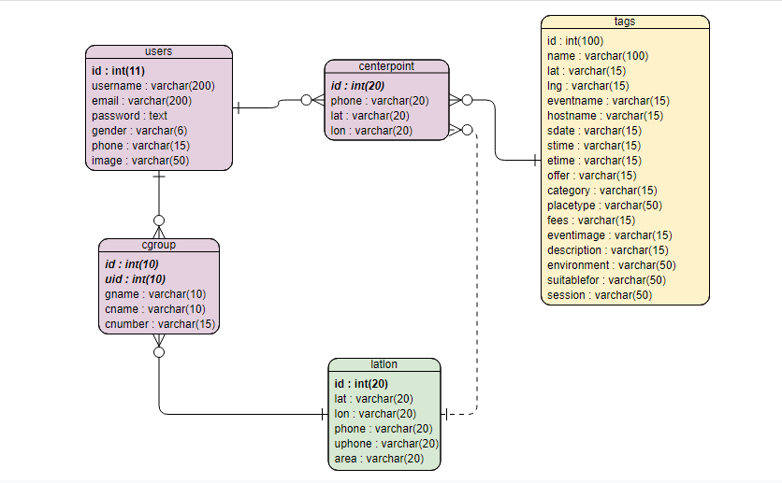
System Design – ER Diagram

Slide 9
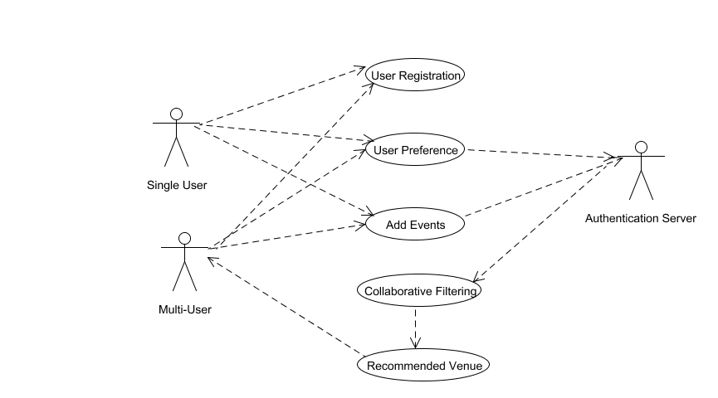
System Design – Use Case Diagram

Slide 10
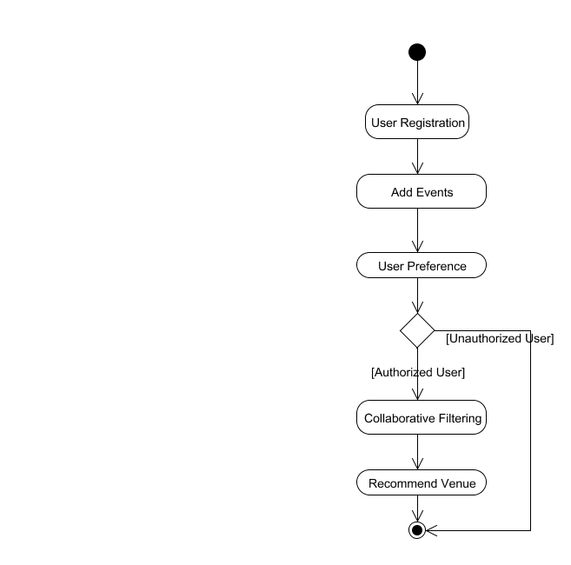
System Design – Activity Diagram

Slide 11
Module Description
Project is designed in four modules where each module is responsible for different aspects.
User Authentication & Create Groups
Add Events and View nearby Events
Single User Recommendation
Group Recommendation

Slide 12
Modules - User Authentication & Create Groups:
User has an initial level Registration Process. The users provide their own personal information for this process.
The server in turn stores the information in its database and user can create a group to add people from their contact list of people in their list.

Slide 13
Modules – Add Events and View Nearby Events:
Proprietor can add the events hosted in their venue .
The Guest Attended the event can add event in database.
User hosting events in their house can also select and add event detail.
User can see list of events hosted within 2km radius from their location.

Slide 14
Modules – Single User Recommendation
User can select their preference on which type of place they wish to attend an event.
All the nearby events which suits the user preference will be displayed in Google map.
User can select and view the location and event hosted in that venue based on the user preference the venues are recommended

Slide 15
Modules - Group Recommendation
In group recommendation end user can select list of people going to participate in an event.
Location of all the selected members will be collected and center point of location gathered calculated and based on user preference venue will be recommended.
User can select the venue and send place details to the group the route map for the location will be displayed for the users.

Slide 16
Testing
Test Case No. | Action | Expected Output | Actual Output | Result
1 | Number of characters of Roll No. is equal to 12 characters | Login button is enabled | Login button is enabled | Pass
2 | Number of characters of Roll No. is less than 12 characters | Login button is disabled | Login button is disabled | Pass
3 | Number of characters of Roll No. is greater than 12 characters | Subsequent characters are not accepted | Subsequent characters are not accepted | Pass
4 | Click Help | Displays Help screen | Displays Help screen | Pass
5 | Enter IP Address | Enters into IP Page ,Connects to Server automatically and home page is displayed | Enters into IP Page ,Connects to Server automatically and home page is displayed | Pass

Slide 17
Testing
Test Case No. | Action | Expected Output | Actual Output | Result
6 | Click Add Group | Displays the list of friends in your contact | Displays the list of friends in your contact | Pass
7 | Click View Group | Display the list of already added groups. | Display the list of already added groups. | Pass
8 | Click Nearby Events | Displays the Location of each event organized near User | Displays the Location of each event organized near User | Pass
9 | Click Add Tags | Asks User to enter his/her preference tags of a event | Asks User to enter his/her preference tags of a event | Pass
10 | Click Log out button | Logout from the app | Logout from the app | Pass

Slide 18
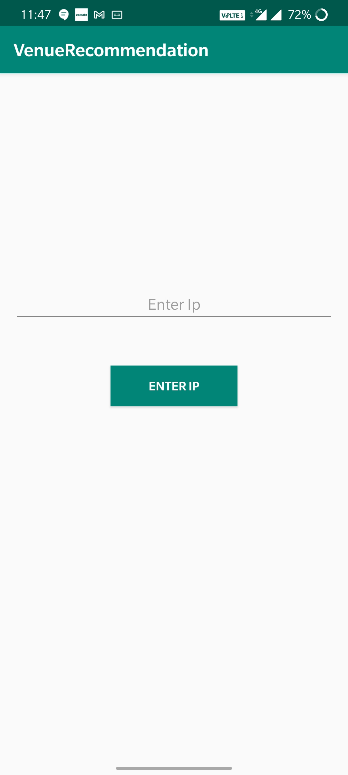
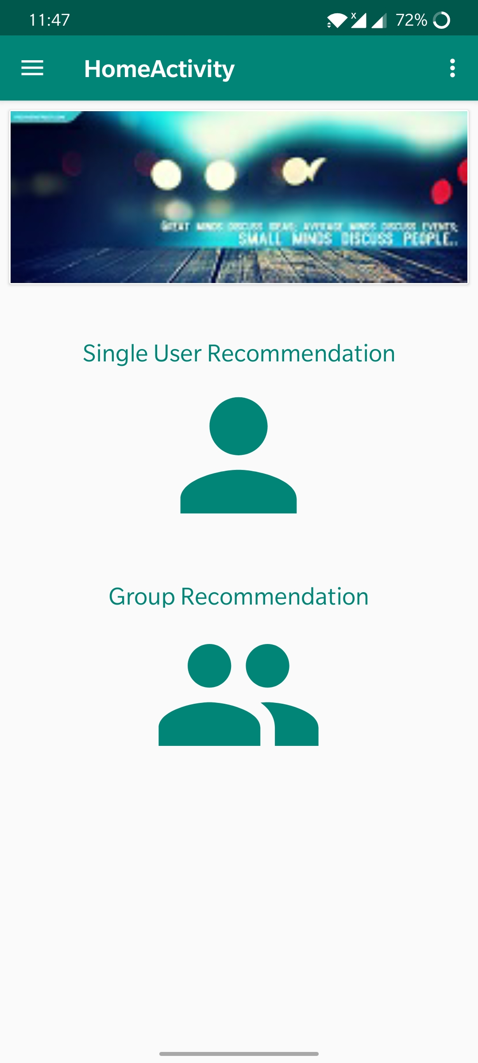
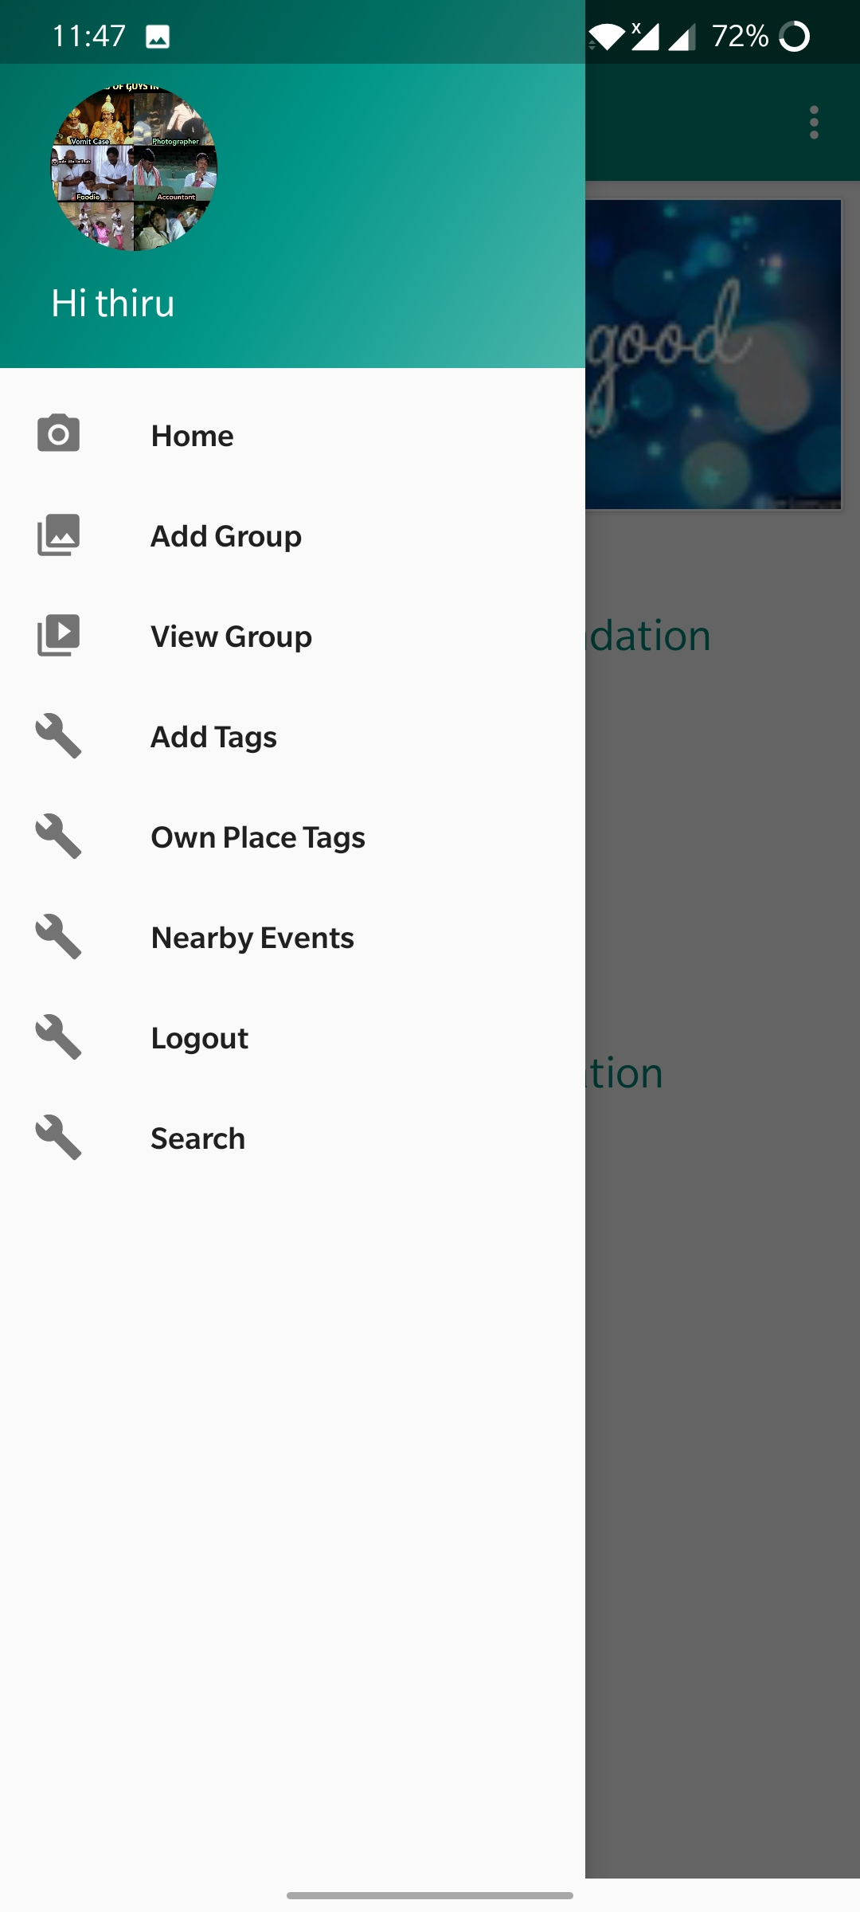
Screenshots

Slide 19
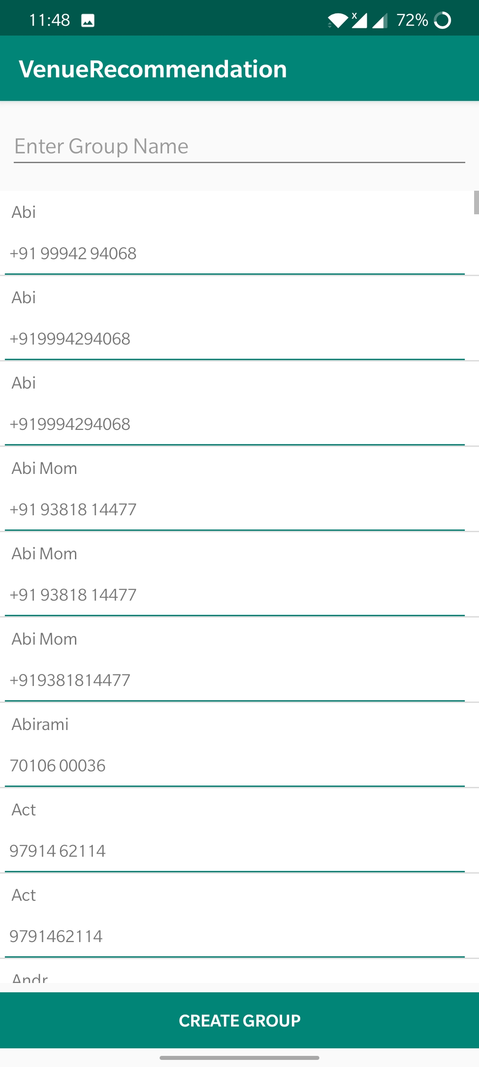
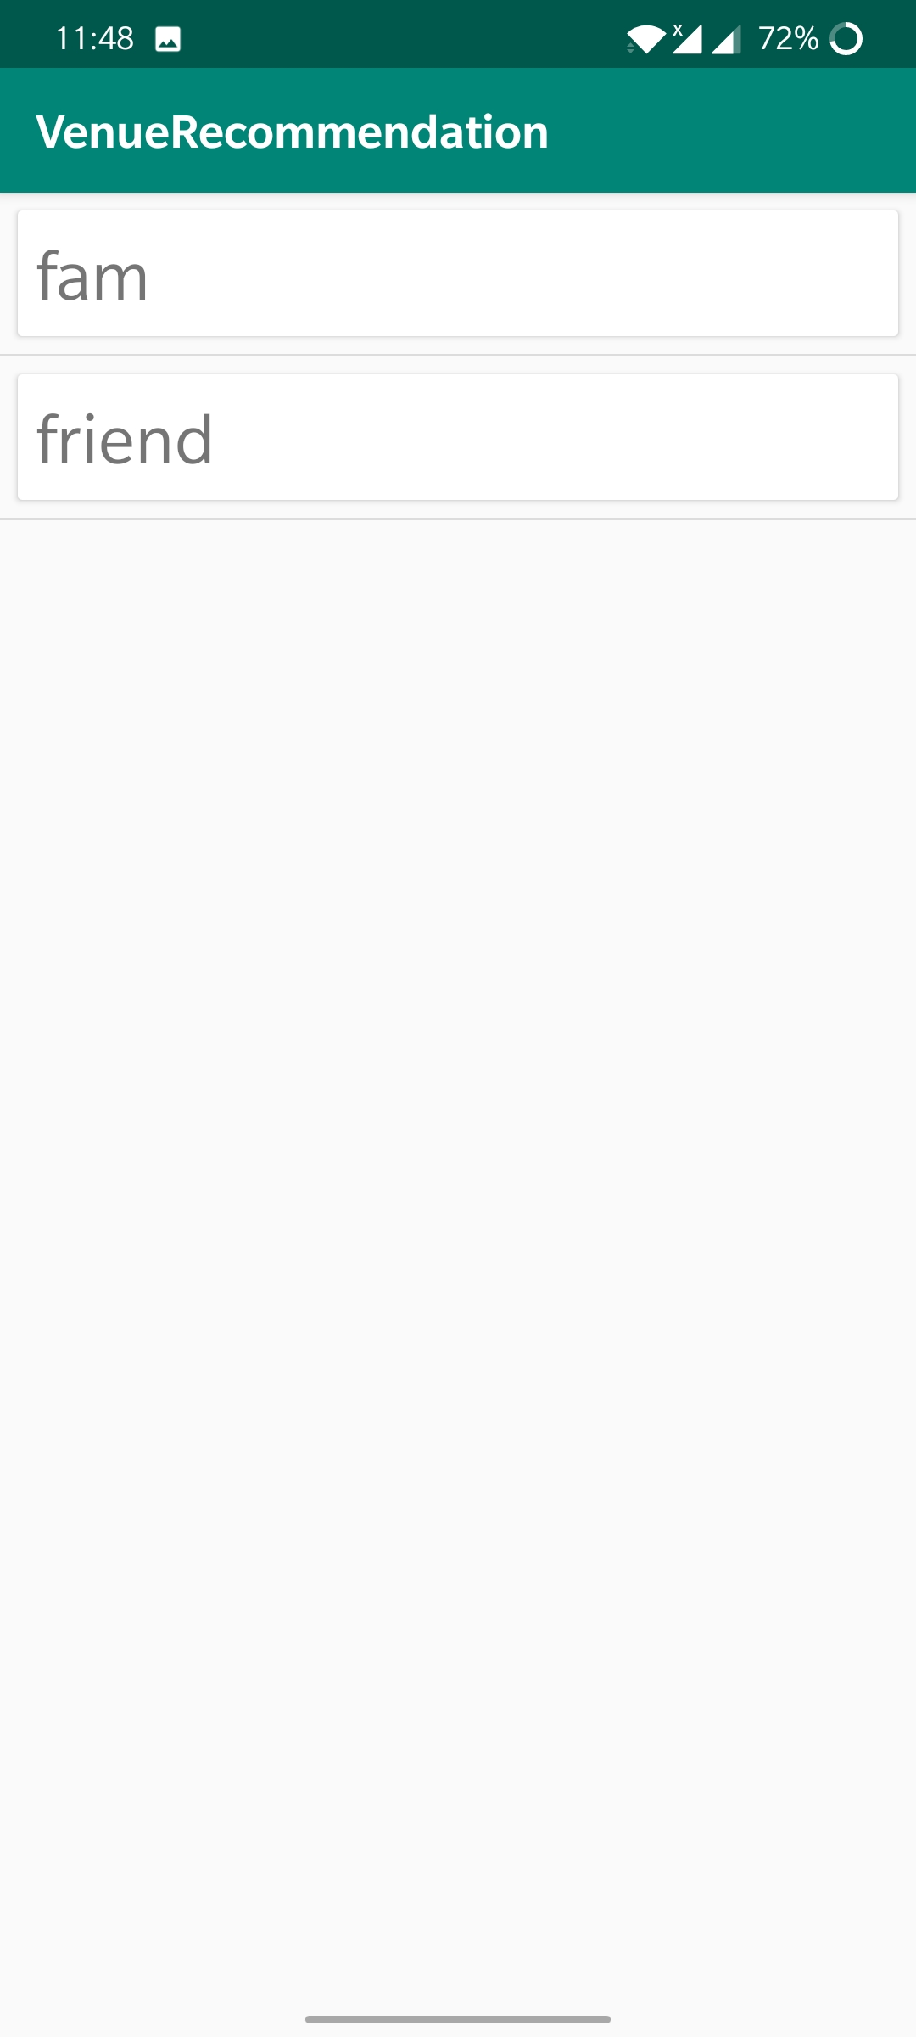
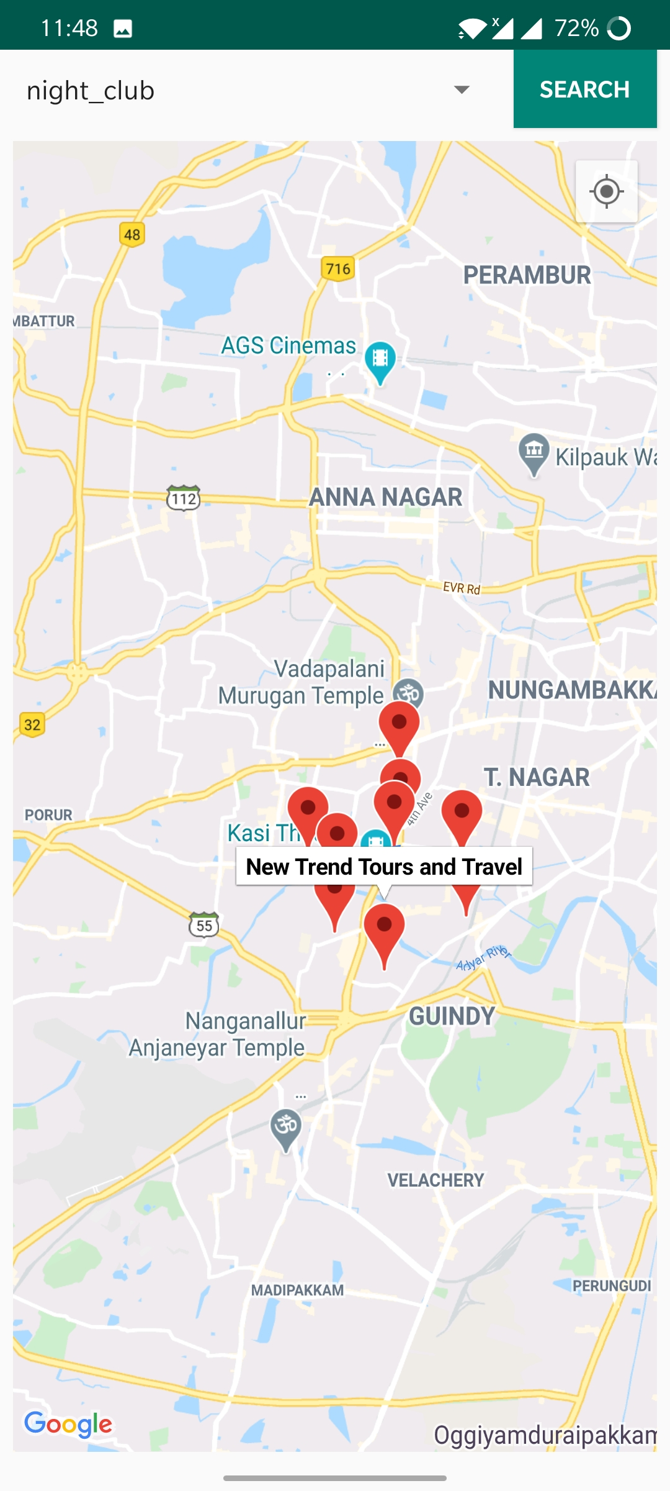
Screenshots

Slide 20
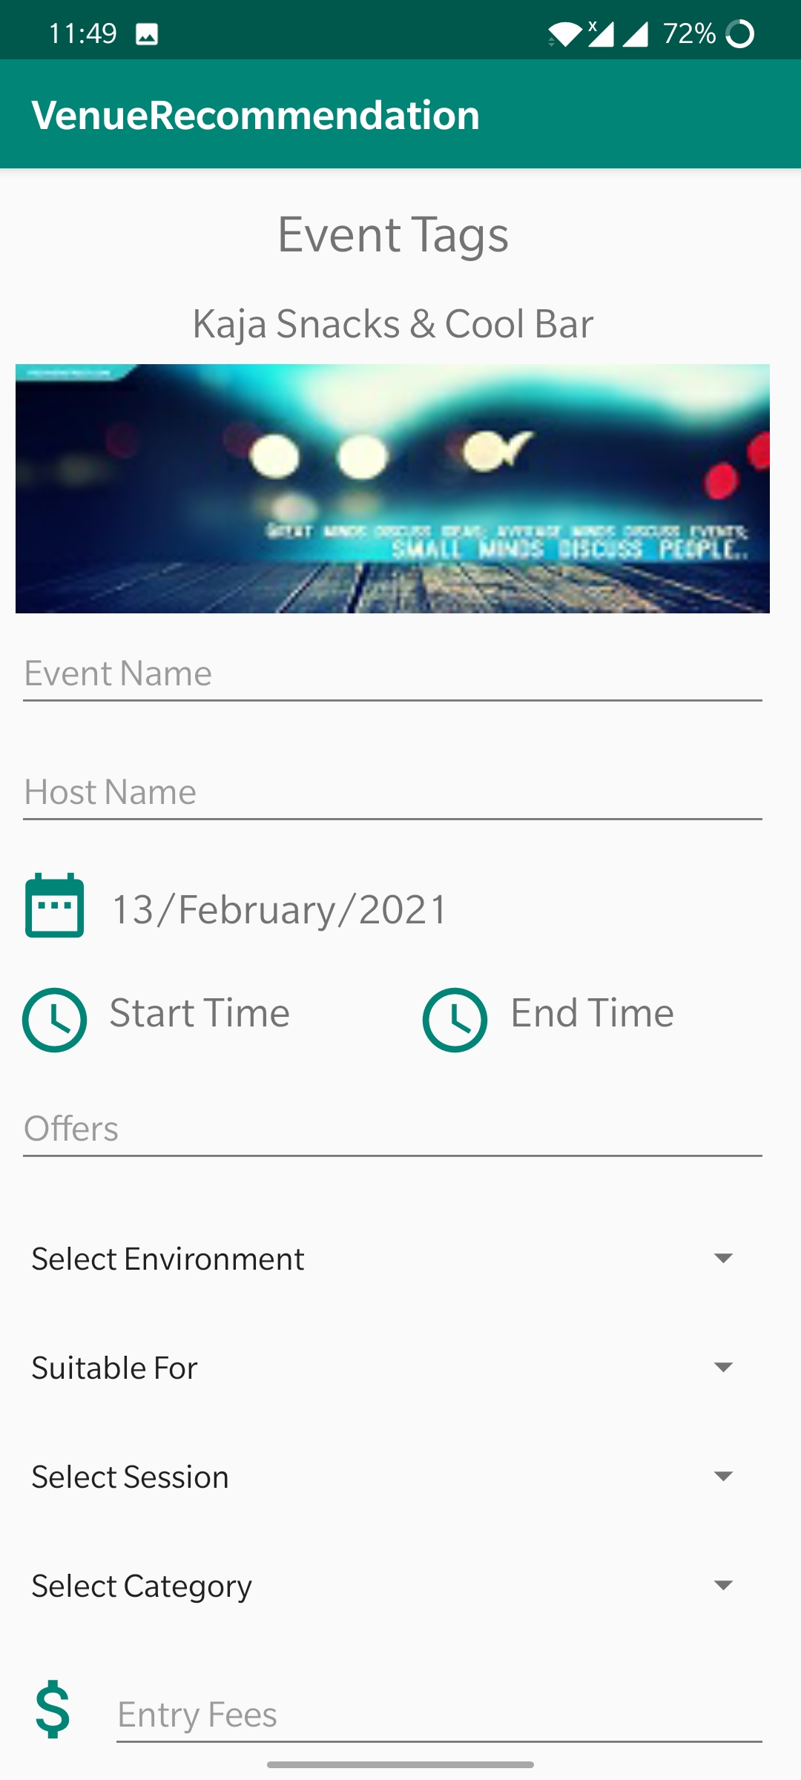
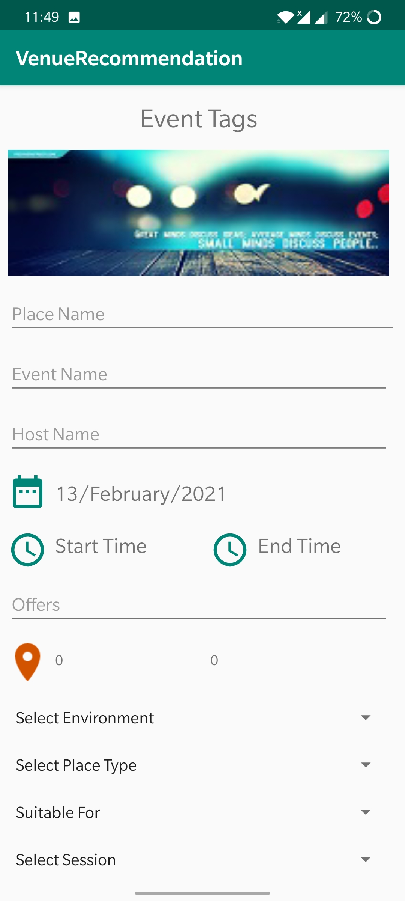
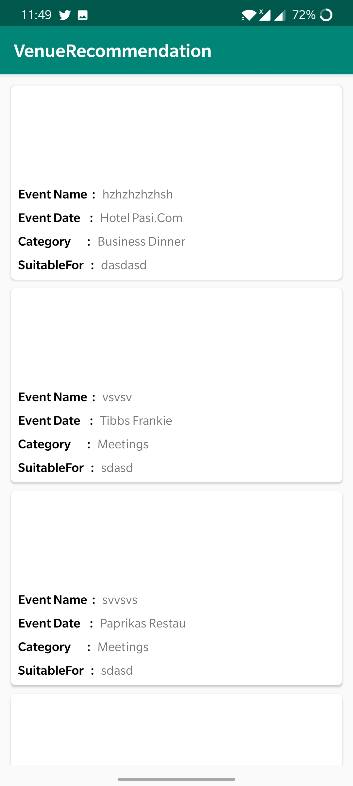
Screenshots

Slide 21
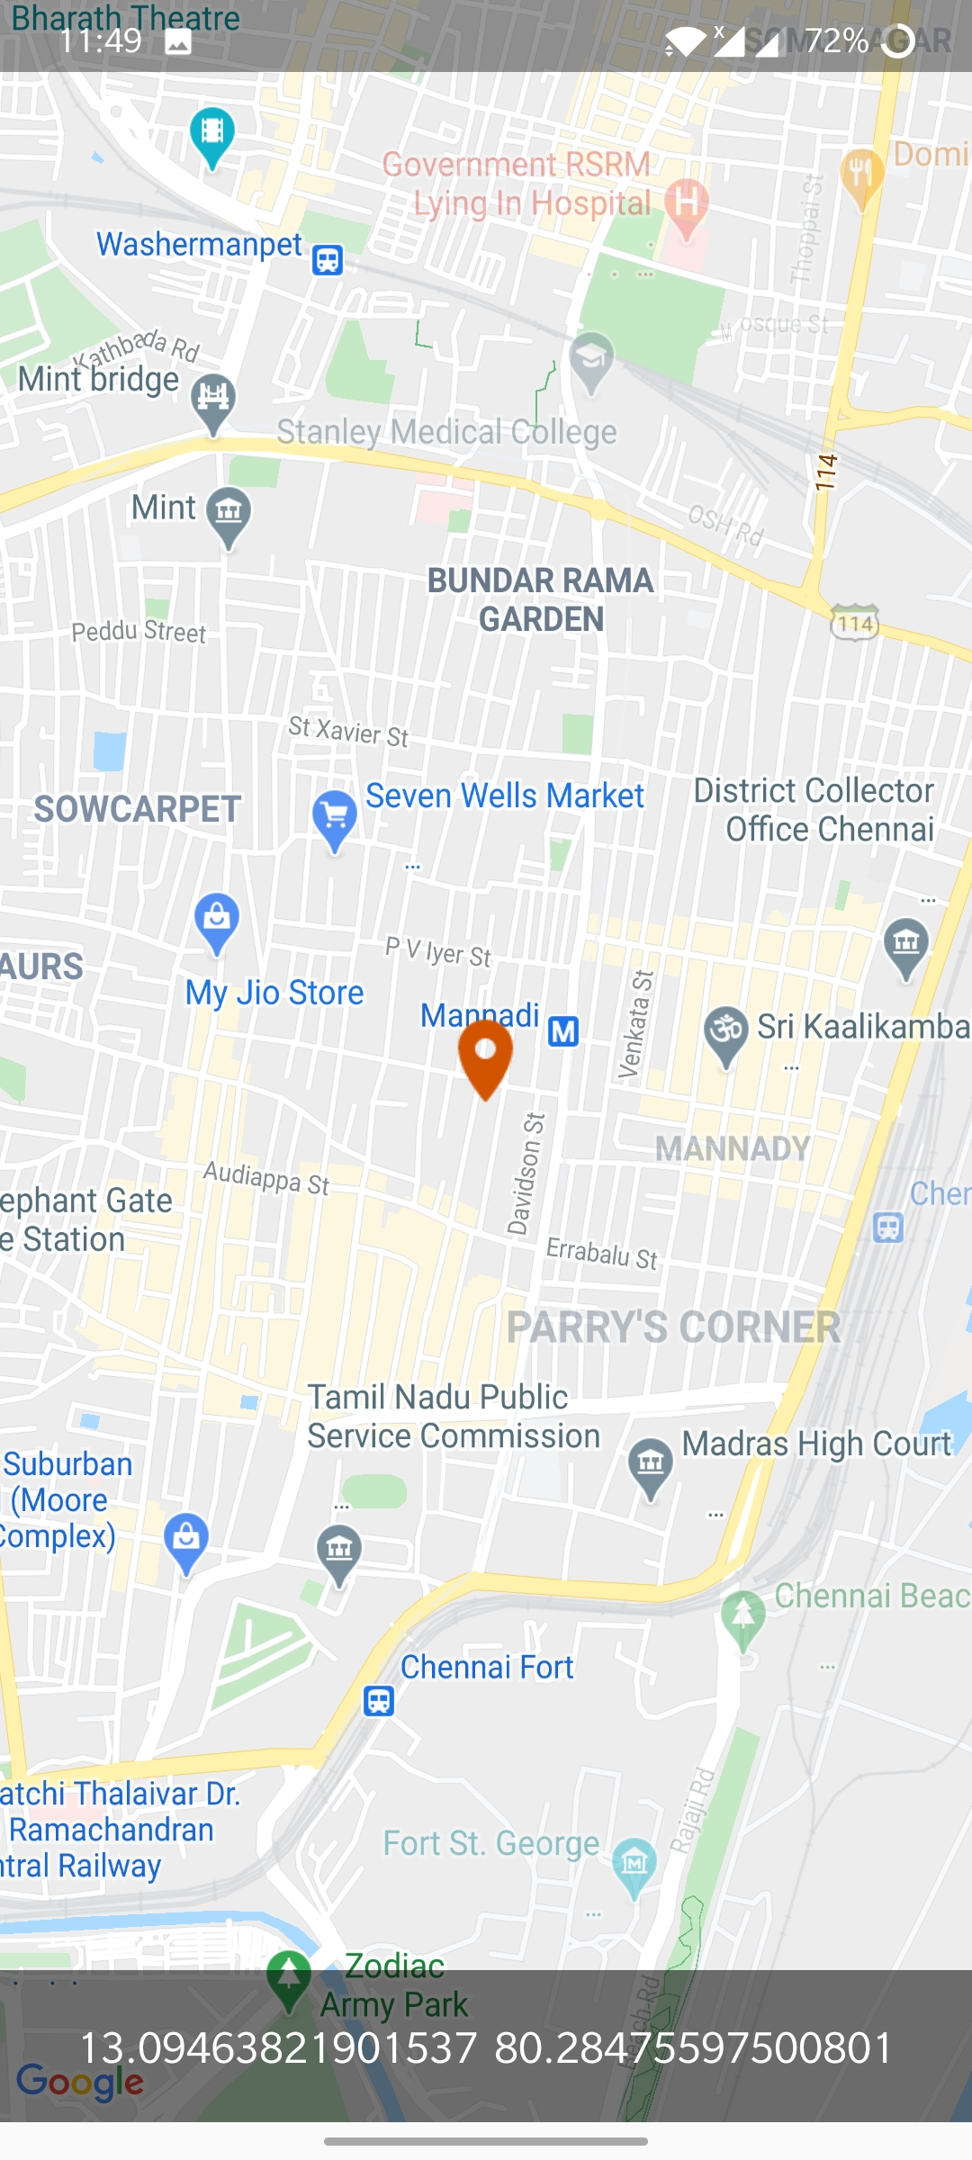
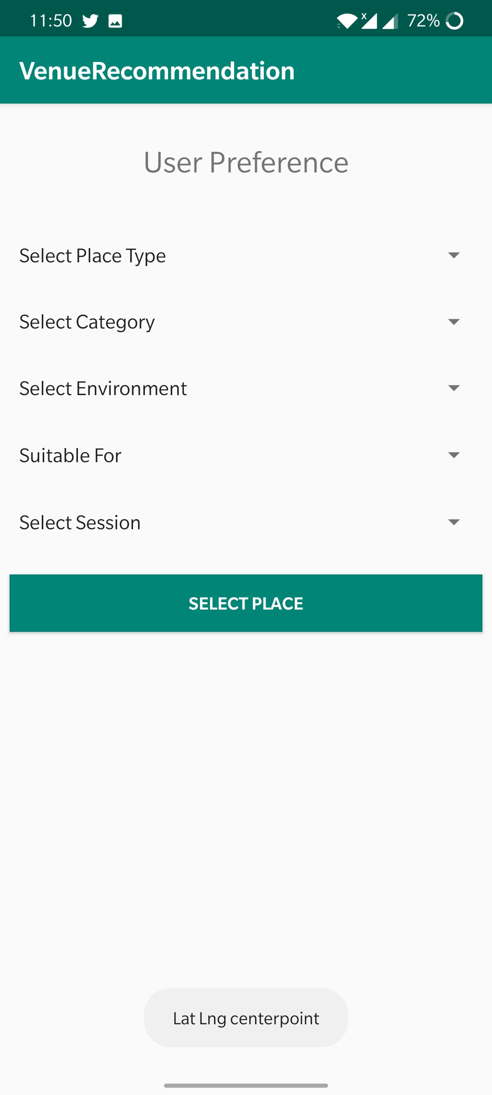
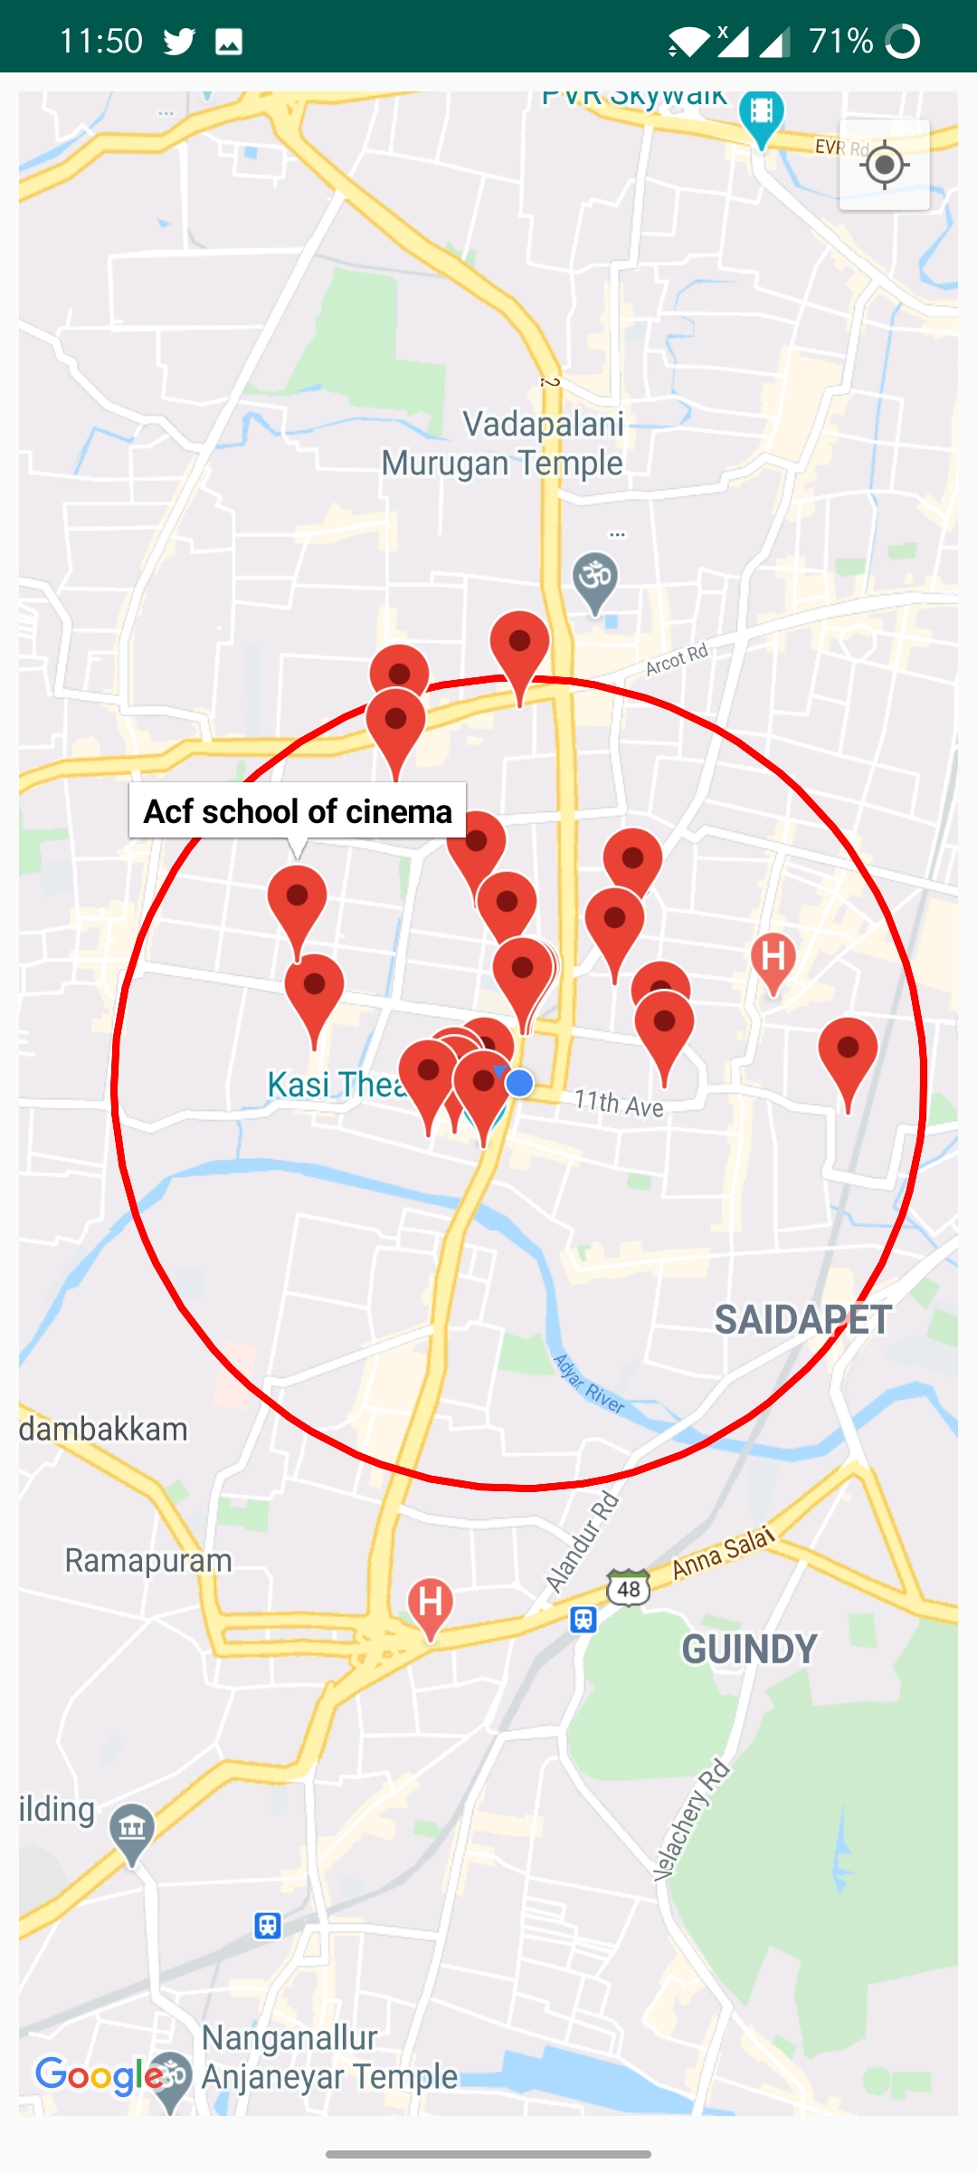
Screenshots

Slide 22
Conclusion
The conclusions of this study suggest that knowledge of specific domain improves the results. This Project has been implemented on Android platform. Also, different attributes have been added to the project which will prove to be advantageous to the system. The requirements and specifications have been listed above.
This project is implemented using Android Studio with xampp and sql. Using the GPS system, the application will automatically display the maps and routes to the different locations and also diplay the venue to user using client-server technology and forward it to the client device.
It uses basic measurements of distance between two locations and provides necessary details of each and every venue nearby people to attend easily.
To Enhance user experience ,we have used some deep learning algorithm to provide recommendations to users.

Slide 23
Future Works
In future there will be an implementation for Notifying the user quickly,if any Liked event is organized nearby.So he/she may not miss the oppurtunity to attend the event.
There will be also Options to search or find a event beyond user location.

Slide 24
References
A. Q. Macedo, L. B. Marinho, and R. L. Santos, “Context-aware event recommendation in event-based social networks,” in Proceedings of RecSys ’15. New York, NY, USA: ACM, 2015, pp. 123– 130.
Z. Qiao, P. Zhang, Y. Cao, C. Zhou, L. Guo, and B. Fang, “Combining heterogenous social and geographical information for event recommendation,” in Proceedings of AAAI Conference on Artificial Intelligence, July 27 -31., 2014, pp. 145–151.
Q. Yuan, G. Cong, and C.-Y. Lin, “COM: A Generative Model for Group Recommendation,” in Proceedings of KDD ’14. New York, NY, USA: ACM, 2014, pp. 163–172.

Slide 25
References
W. Zhang, J. Wang, and W. Feng, “Combining latent factor model with location features for event-based group recommendation,” in Proceedings of KDD ’13. New York, NY, USA: ACM, 2013, pp. 910–918.
X. Liu, Q. He, Y. Tian, W.-C. Lee, J. McPherson, and J. Han, “Event-based social networks: Linking the online and offline social worlds,” in Proceedings of KDD ’12. New York, NY, USA: ACM, 2012, pp. 1032–1040.
S. Purushotham and C.-C. J. Kuo, “Personalized group recommender systems for location- and event-based social networks,” ACM Trans. Spatial Algorithms Syst., vol. 2, no. 4, pp. 16:1–16:29, Nov. 2016.

Slide 26
References
P. Lops, M. De Gemmis, and G. Semeraro, “Content-based recommender systems: State of the art and trends,” in Recommender handbook. Springer, 2011, pp. 73–105.
A. Mnih and R. R. Salakhutdinov, “Probabilistic matrix factorization,” in Procedings of NIPS ’08, 2008, pp. 1257–1264.
B. Liu, H. Xiong, S. Papadimitriou, Y. Fu, and Z. Yao, “A general geographical probabilistic factor model for point of interest recommendation,” IEEE Transactions on Knowledge and Data Engineering, vol. 27, no. 5, pp. 1167–1179, May 2015.
H. Yin, X. Zhou, B. Cui, H. Wang, K. Zheng, and Q. V. Nguyen, “Adapting to user interest drift for poi recommendation,” IEEE Transactions on Knowledge and Data Engineering, vol. 28, no. 10, pp. 2566–2581, Oct. 2016.

Slide 27
THank you

